Slide 1
Unplugged
Reality TV Show
Group 5: Samir Toribio, Vrinda Arora, Krishi Shah, Yangjee Sherpa, Yifan Zang

Slide 2

Table of Contents
01
04
02
05
03
06
Who are we?
Producer
What is Unplugged?
Advertising
Episode Overview
Budget

Slide 3
Byte-Sized is a leader in the entertainment field
Our company
A vision to create content addressing technology dependency to promote a healthier, balanced lifestyle
Aim to bridge the gap between the digital world & real life experiences
Creating content that is entertaining yet educational

Slide 4

Unplugged: A new reality TV concept
Target Audience: Tech-savvy Gen Z and Millennials eager to disconnect from technology and reconnect with nature
Concept: Unplugged promises intense emotional engagement through themes of digital detox
Format: Contestants engage in a variety of competitions on a remote island, earning points through challenges for a chance to win $100,000

Slide 5
Episode Overview

Slide 6
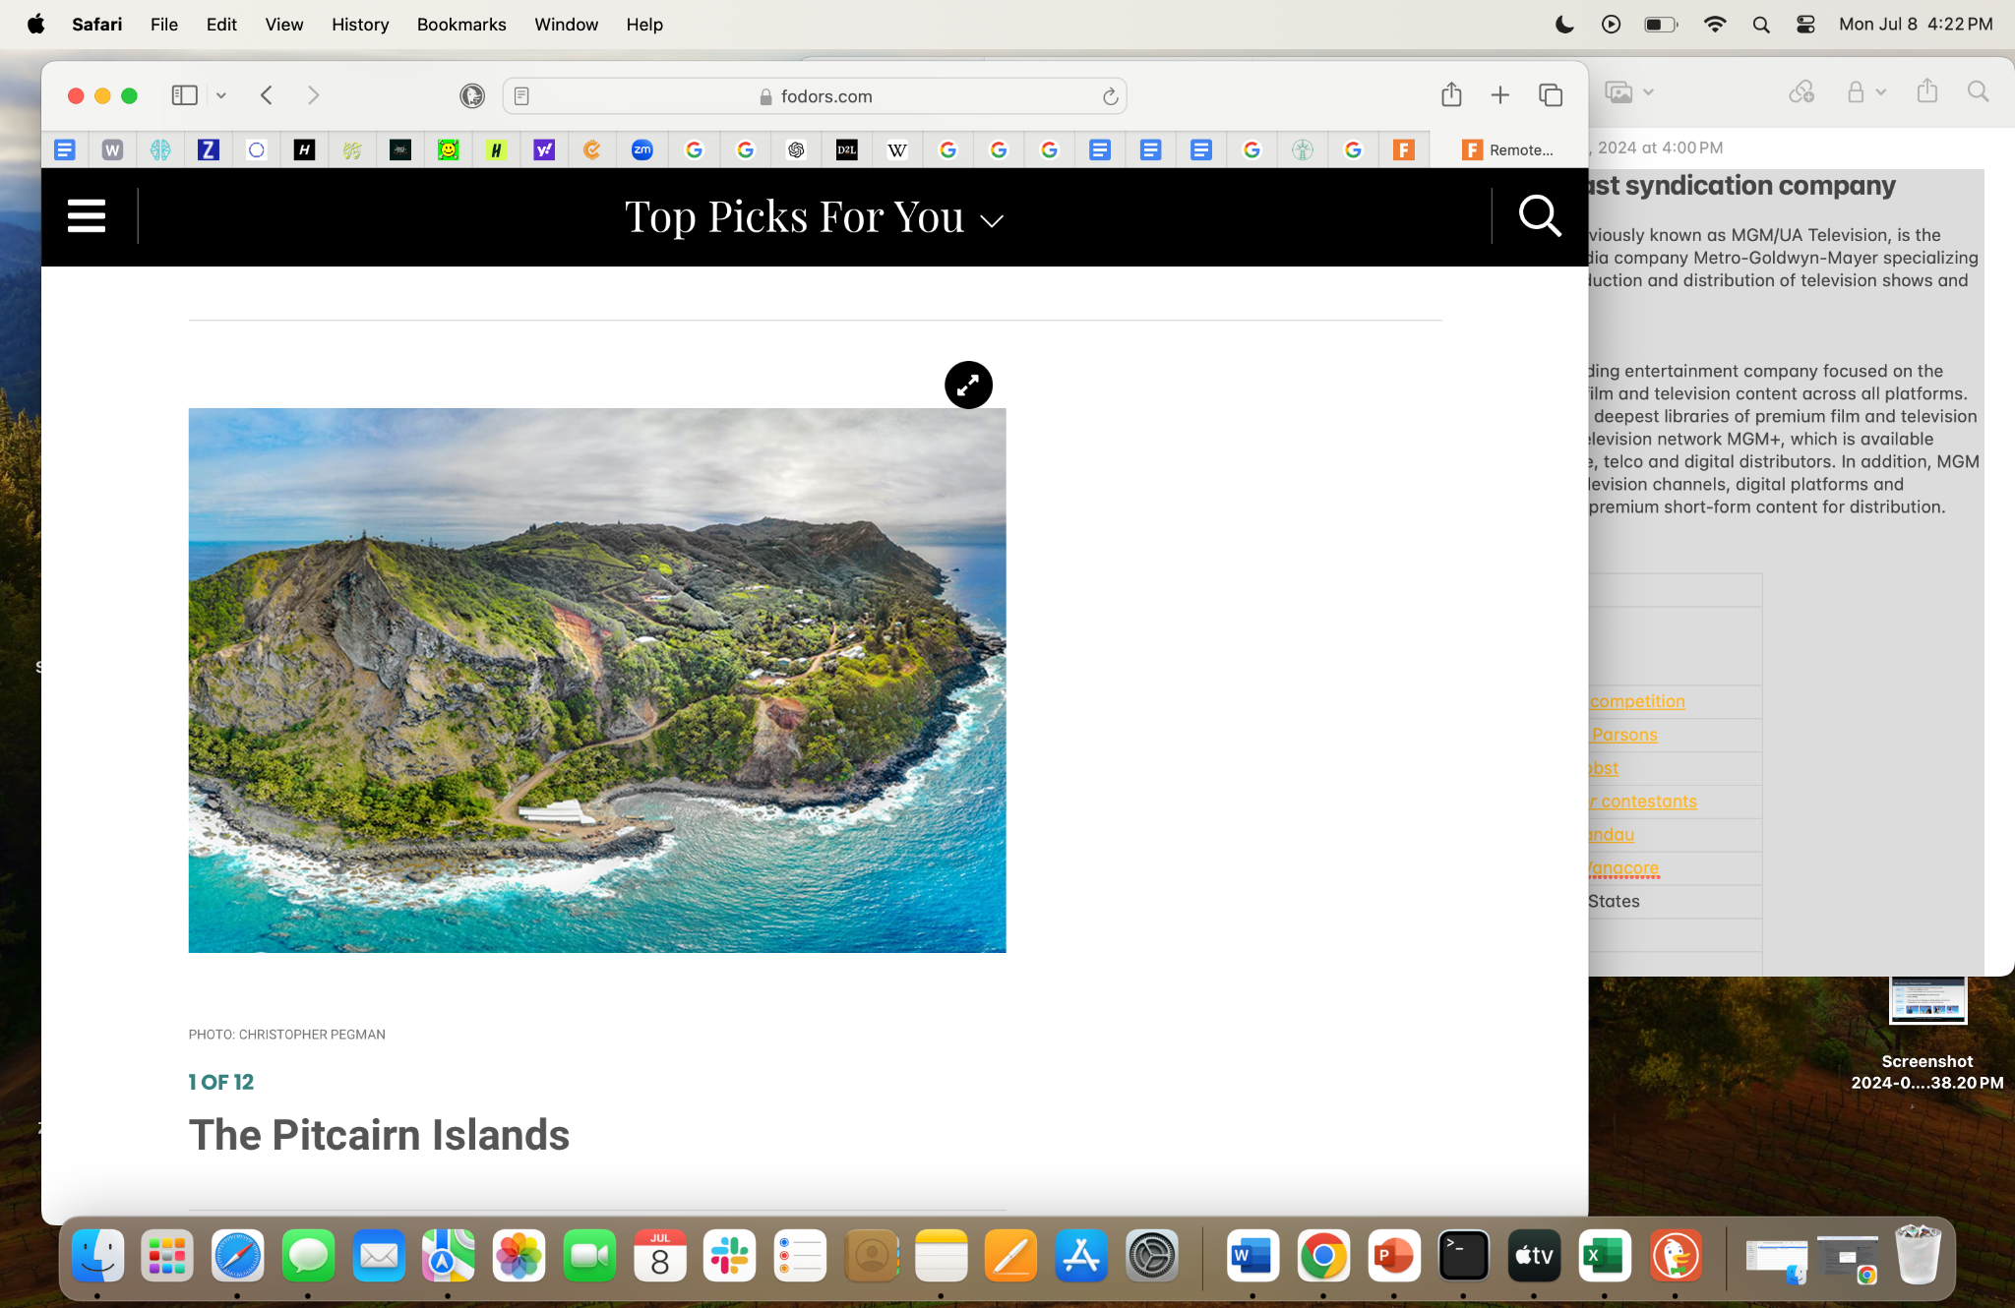
Recap & Episode 1
Episode 1: "Island Beginnings"
4 major players' journey starts on a remote island and engage in a 2 week digital detox challenge
Key Plots of EP1:
Settling In and Surrender device
Initial Interviews: Conduct initial interviews SWOT, mental health & Tech device Q&A
Exploration: Explore the commercial area, discover local resources, make friends and form strategic alliances.
Notes:
The stunning scenery and raw emotions of the contestants provide a captivating start, ensuring viewers are hooked from the very beginning.Real World Example of such a location can be Wellesley Island in New York States

Slide 7
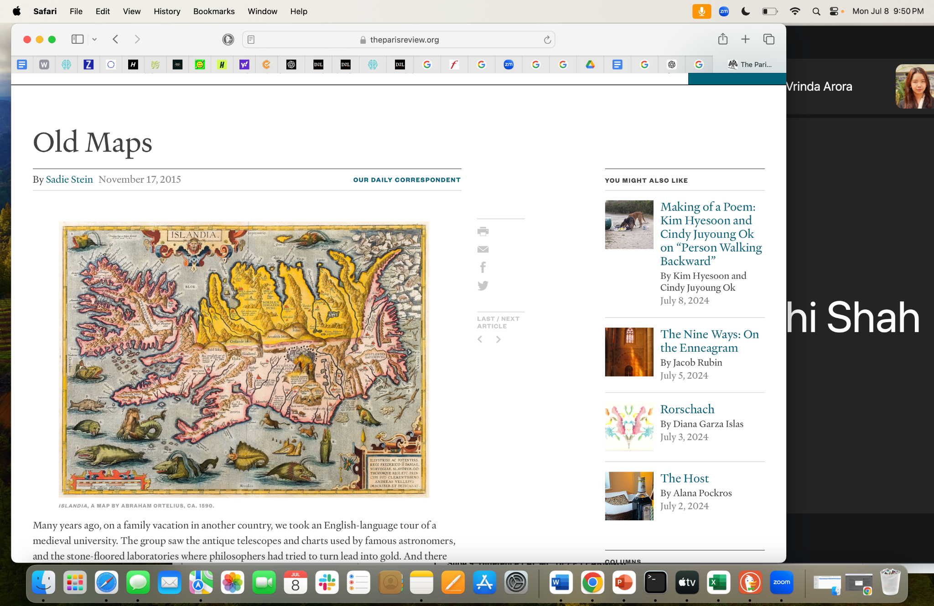
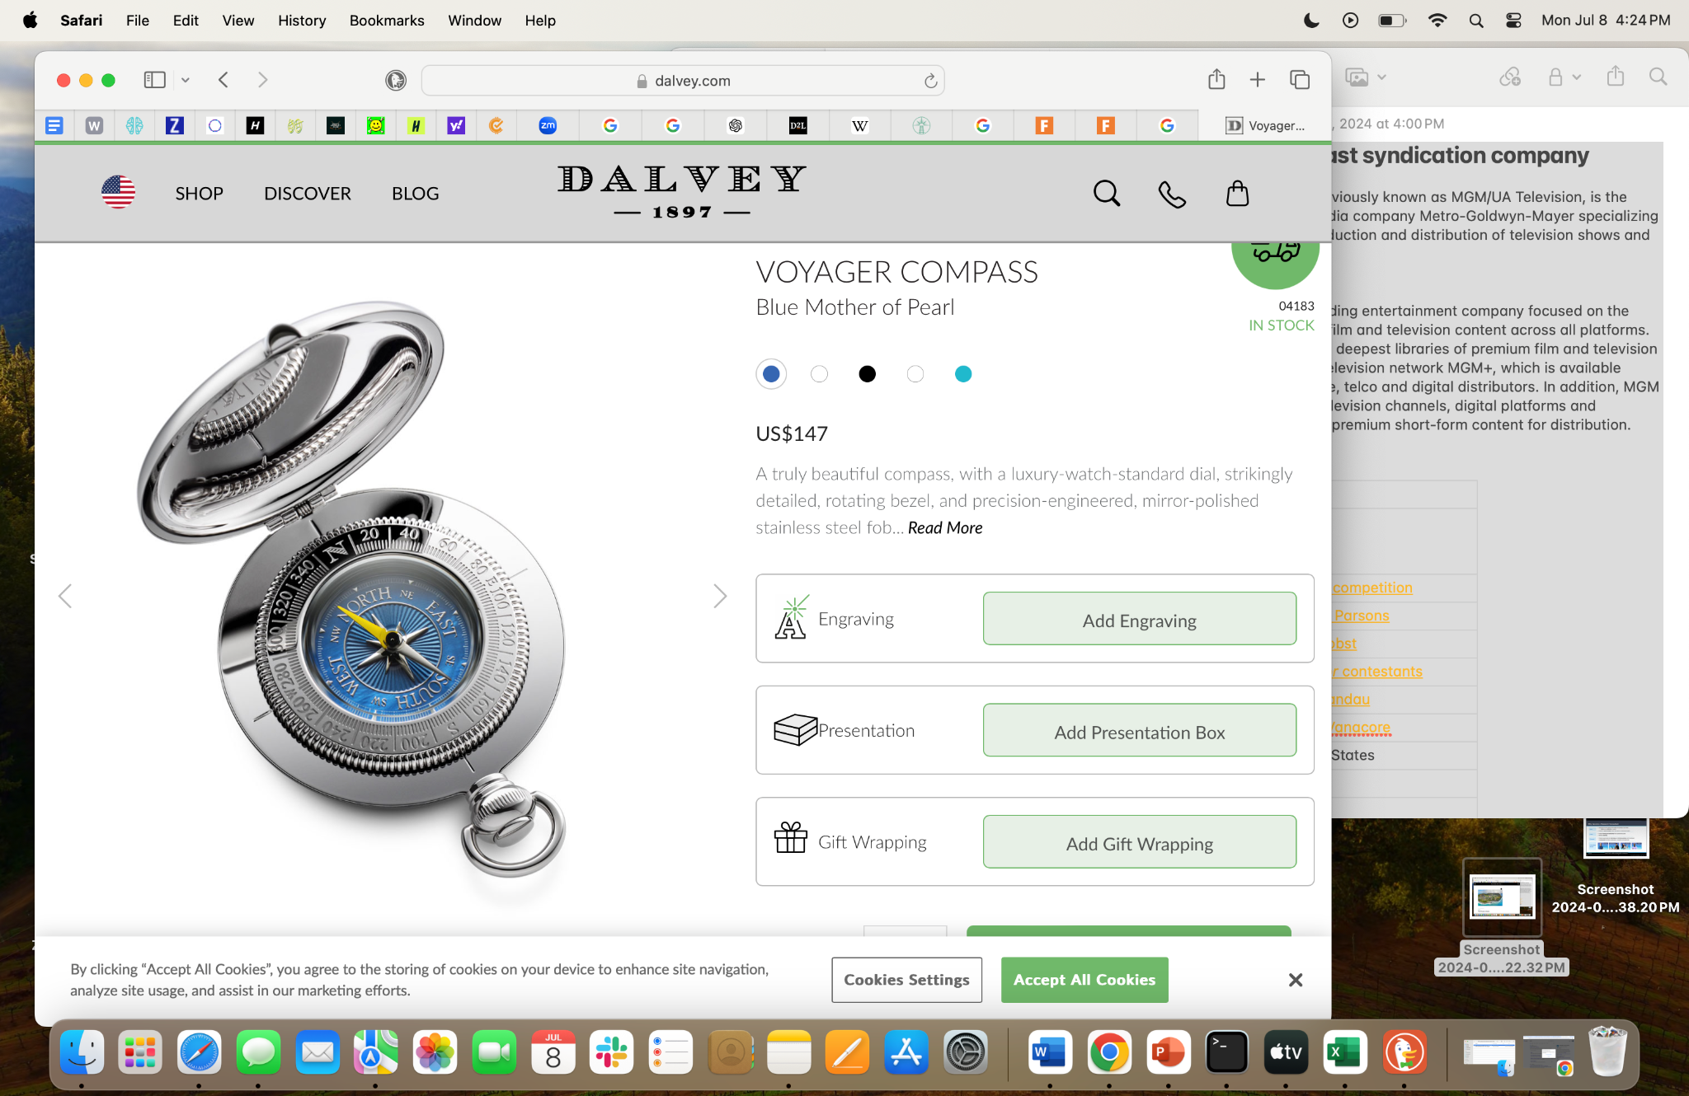
Episode 2 & 3
Episode 2: "Navigating the Unknown"
Key Plots of EP2:
Map Navigation: 1 Hour map navigation contest towards local checkmarks.
Evaluation: Compete for Accuracy and Minimal Time Usage
Episode 3: "Art of Entertainment"
Key Plots of EP3:
Form Local Alliance : collaborate to prepare for talent performance
Show Time: stand-up comedy, dance, songwriting and sand painting,etc.
This episode helps reveal another layer of participants’ personalities.

Slide 8
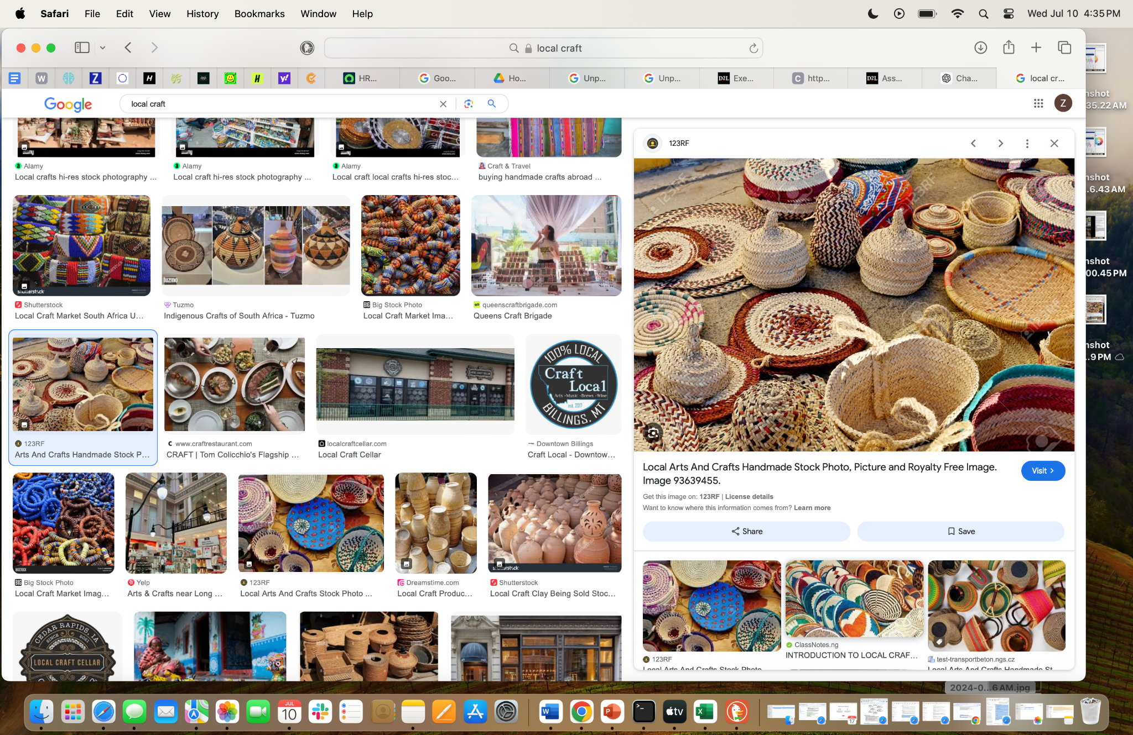
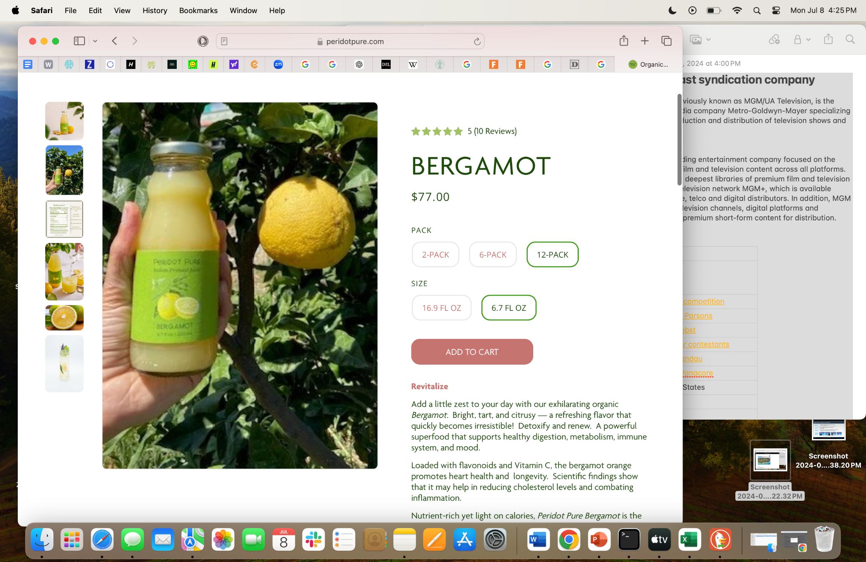
Episode 4 & 5
Episode 4: "Island Commerce"
"Island Commerce" brings an entrepreneurial twist to the competition.
Key Plots of EP4:
Product Sales: Contestants can create products using local raw materials or sell local products, earning scores based on their sales success.
Pitch Plan Creation : help local business owners co-create a pitch plan to outside investors
Episode 5: "Island Influencer"
Contestants will engage in a high-stakes networking session with island residents, judges, and the event production crew using 3 hours. This episode highlights the importance of personal branding and the ability to influence and inspire others to get votes and recommendation.

Slide 9
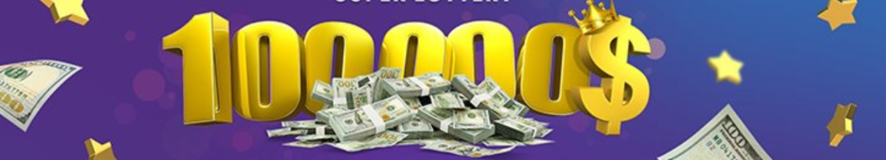
Episode 6
Episode 6: "The Moments"
The judging committee tallies the total votes each contestant has earned and award ceremony will be held.
Key Plots of EP 6:
Award Ceremony
Final Interviews: final interviews for contestants regarding their opinions of the electronic devices and how to use it responsibly and strategically.
Summary: Throughout the whole season, key elements of the episodes are survive, competition, social connection, personal growth and digital detox intervention. The key idea of such reality show is to encourage meaningful interpersonal connection and personal growth.

Slide 10
Production

Slide 11

Address our Production Process
The Shows Role for the Production Company
Our reality show “Unplugged”, was inspired by MGM’s reputation in creating an engaging content for our audience, leveraging the show to life.
We observed that the of viewers watching will be interested in the competitive reality game show, that will offer emotional intensity and competition.

Slide 12

MGM’s Film Making Era
Innovative Filmmaking
- MGM Studios has recognized for its outstanding filmmaking, featuring iconic films such as James Bond and Pink Panther.
Diverse Genres
-They offer a wide variety of franchise films catering to a large audience. The variations of genres include drama, comedy, action, music, and fashion.
Brand Loyalty
-In the entertainment world of all time cinemas, MGM has a long history
producing film and television. Its brand icon has been famous for its iconic
lion for years in the making.
Open to new projects
- MGM is dedicated to both new and existing television projects, with a mission to empower the reality of television.

Slide 13
Advertising &
Brand Sponsorships

Slide 14
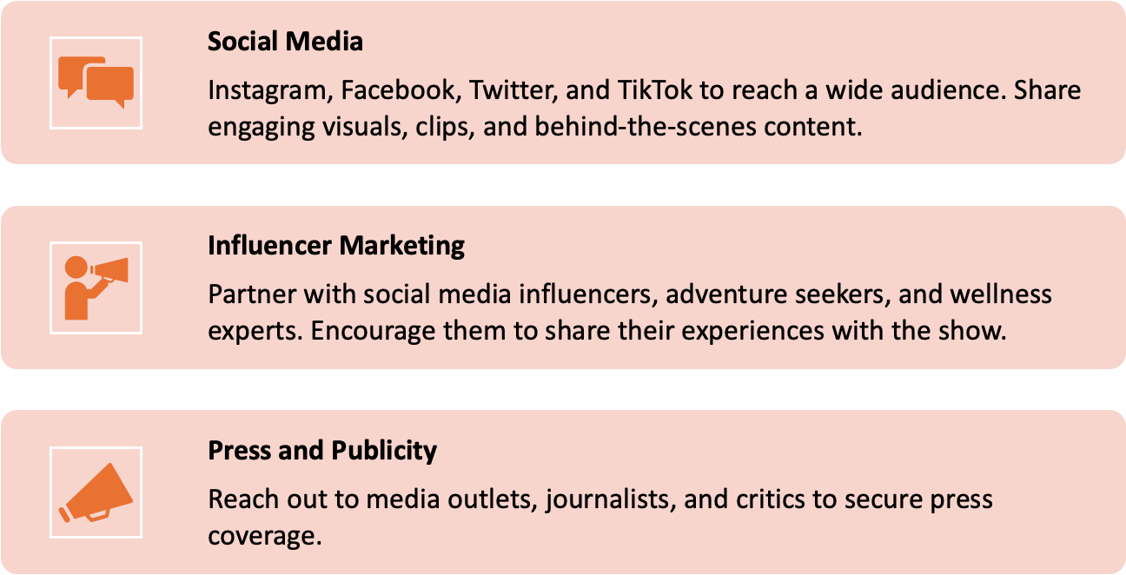
Channels for Promoting Unplugged

Slide 15
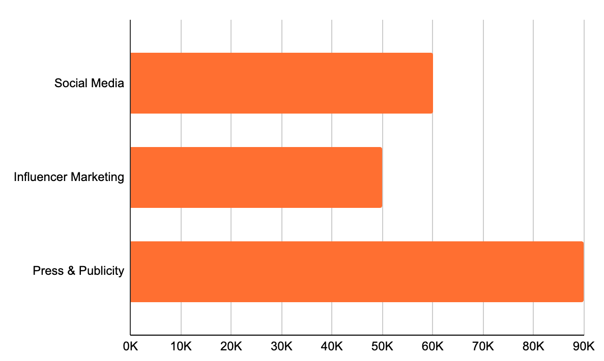
Projected Ad Spends on Different Channels
Medium
Budget allocated (in $)

Slide 16






Product Placement and Brand Sponsors

Slide 17
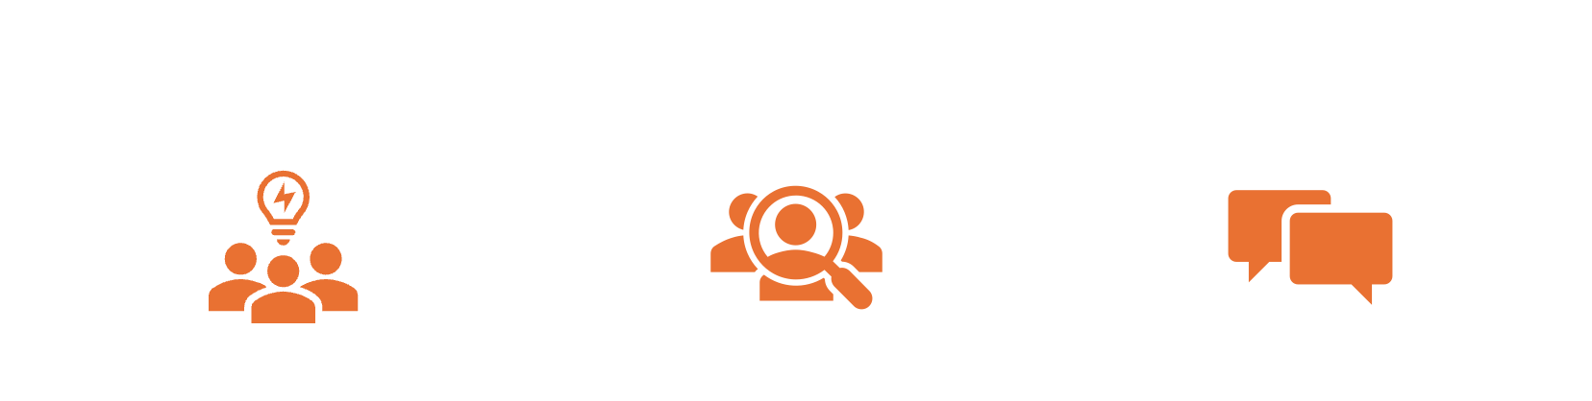
Strategic Brand Sponsorships
Aligns with the show’s themes of adventure, wellness, and self-discovery
Target audience matches the advertisers’ desired demographics
Potential for social media and influencer marketing amplification

Slide 18
Revenue from Brand Sponsorships
Brand | Cost of Advertising (per integration) | No. of Integrations | Revenue Generated | How the product will be integrated?
Larabar | $50K | 4 | $200K | Snack and nutrition segments, Product placements during challenges, Larabar celebration packs for finale contestants
Air BnB | $62.5K | 4 | $250K | Airbnb-sponsored navigation contest with an Airbnb stay as a prize
Headspace | $25K | 6 | $150K | Regular meditation breaks, Headspace meditation session before finale challenge
The North Face | $60K | 5 | $300K | North Face clothing and gear to be used for challenges
Aveda | $60K | 5 | $300K | Contestants using Aveda products before challenges, goodie bags
TUMI | $50K | 6 | $300K | TUMI products for finale winners, display during transit to remote island

Slide 19
Budget

Slide 20
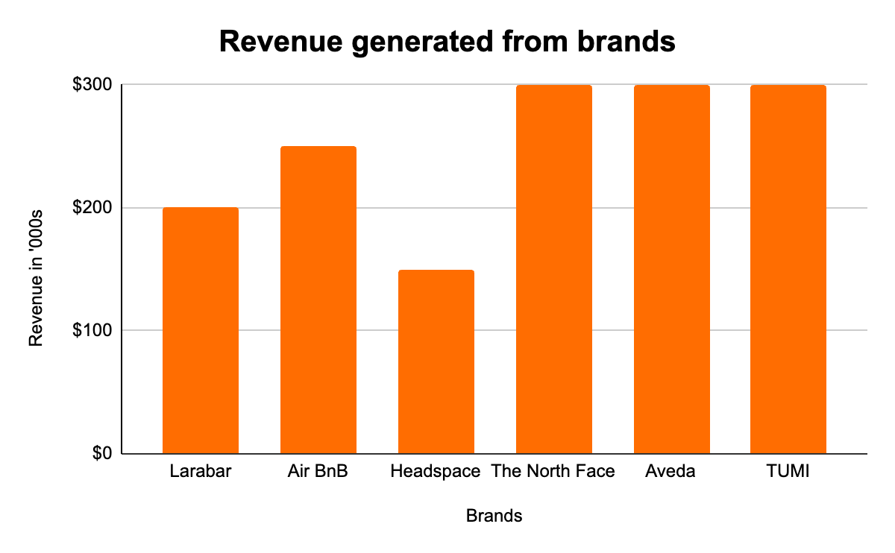
Efficient budget focus to prioritize authenticity.
$1,500,000
$670,000
55%
Product | $ | Allocation (%)
Development | 40k | 6%
Talent | 30k | 4%
Production | 200k | 30%
Marketing | 200k | 30%
Post-Production | 90k | 13%
Monetary Prize | 100k | 15%
Contingency | 10k | 2%
Revenue
Total Costs
ROI
Projected AD Revenue
Revenue in ‘000s
Brands

Slide 21
Value of Unplugged is beyond financial returns.
$1.5 M
Audience Reach & Engagement
Creative Vision
Social & Cultural Impact

Slide 22
Unlock the untold stories of the island.
Make waves with Unplugged!

Slide 23
Thank you!
Let’s connect
bytesized@entertainment.com
(929) 767 5543
bytesizedentertainment.com

